Slide 1
Natural Language Processing
Unit 7 POS Tagging
Faizan Javed
DataScience @ SMU

Slide 2
Admin notes
Live session 9 – Midterm (no class)

Slide 3
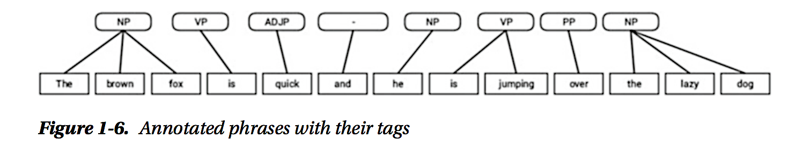
Part of Speech (POS) Tagging
POS tagging can help determine important keywords in a document and assist in finding specific usages of a word (“Will” as a noun vs “will” as a verb)
Structure hierarchy:
Sentence > Clause > Phrase > Word
Word: Smallest language unit, has four major categories Noun, Verb, Adjective, Adverb
Phrase: usually groups of two or more words (without both subject and verb), has 5 major categories NP, VP, ADJP, ADVP, and Prepositional Phrase. Used as part of sentences
Shallow parsing is used to extract phrases.

Slide 4
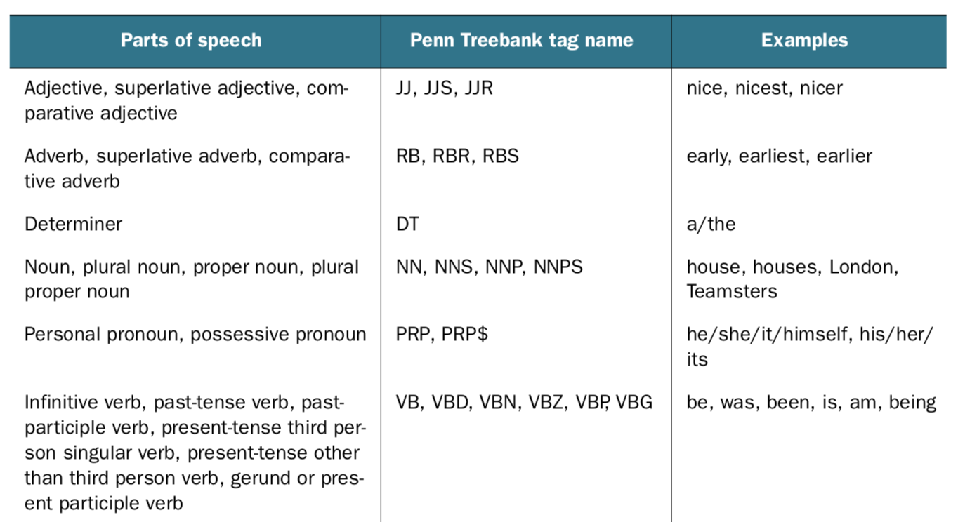
Part of Speech (POS) Tagging

Slide 5
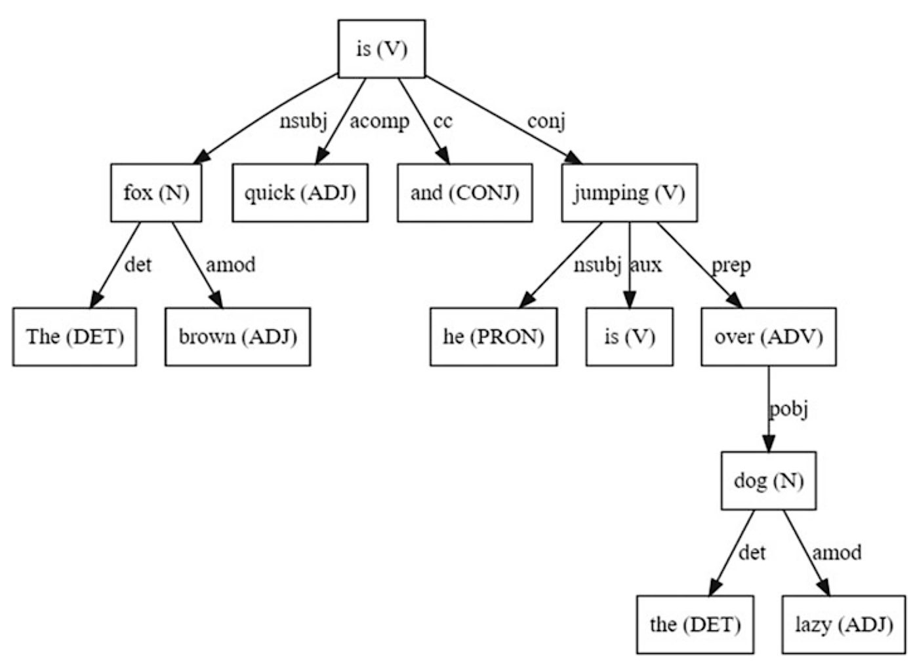
Dependency Grammars
Grammar: defines the syntax and structure of language.
Dependency grammar (word-based grammars): A word has a relation or depends on another word based on the positioning of the words in the sentence
Directed acyclic graph (DAG): Every node in the tree has at most one incoming edge, except the root node.
Examples:
det →(fox, the), (dog, the)
nsub (entity that acts as a subject of agent)
→ (is, fox), (jumping, he)

Slide 6
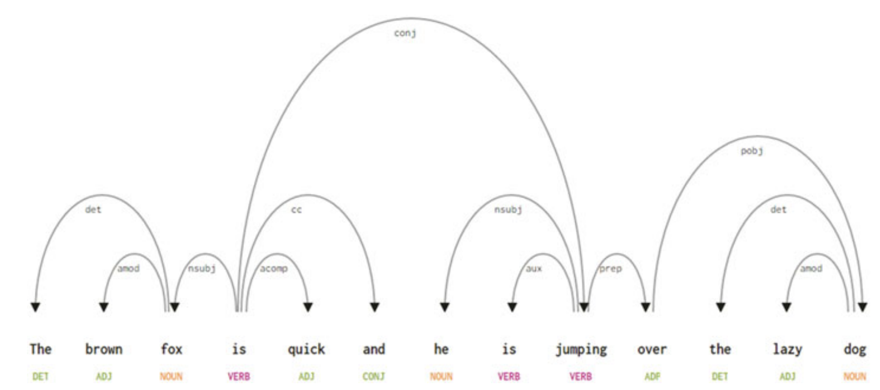
Dependency Grammars

Slide 7
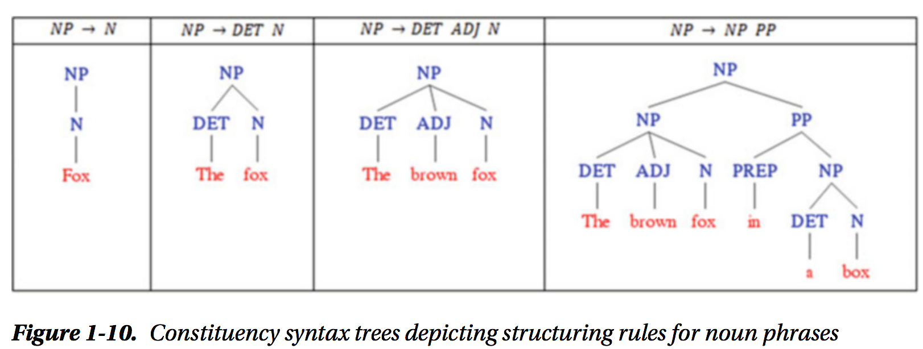
Constituency Grammars (phrase structure grammars)
Syntax and rules that govern the hierarchy and ordering of the various constituents in the sentences.
What words are used to construct the phrases or constituents
How to order these constituents together

Slide 8
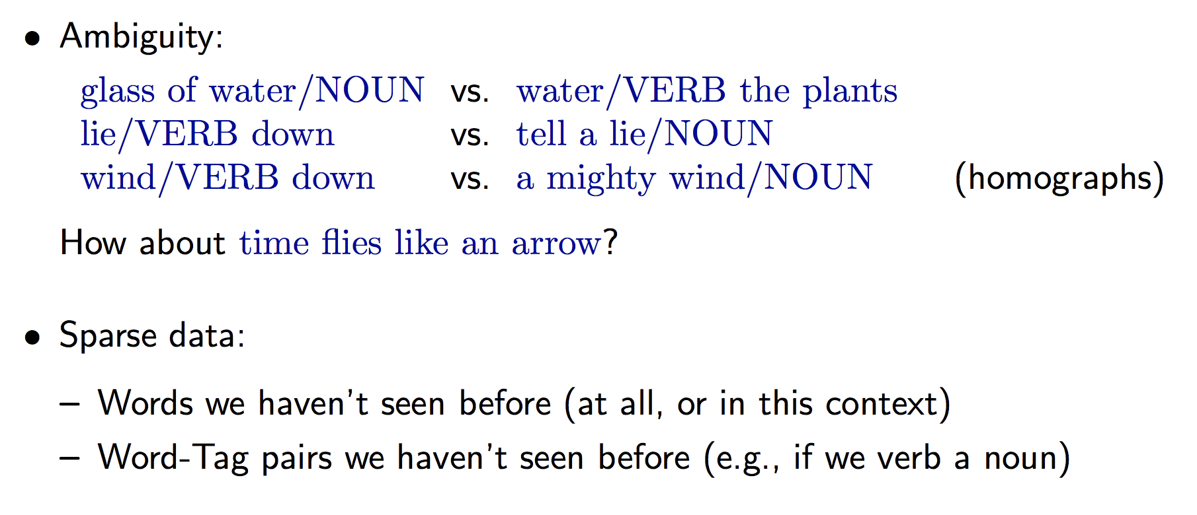
Why is POS tagging hard?
Notes:
Krovetz is a dictionary based stemmer

Slide 9
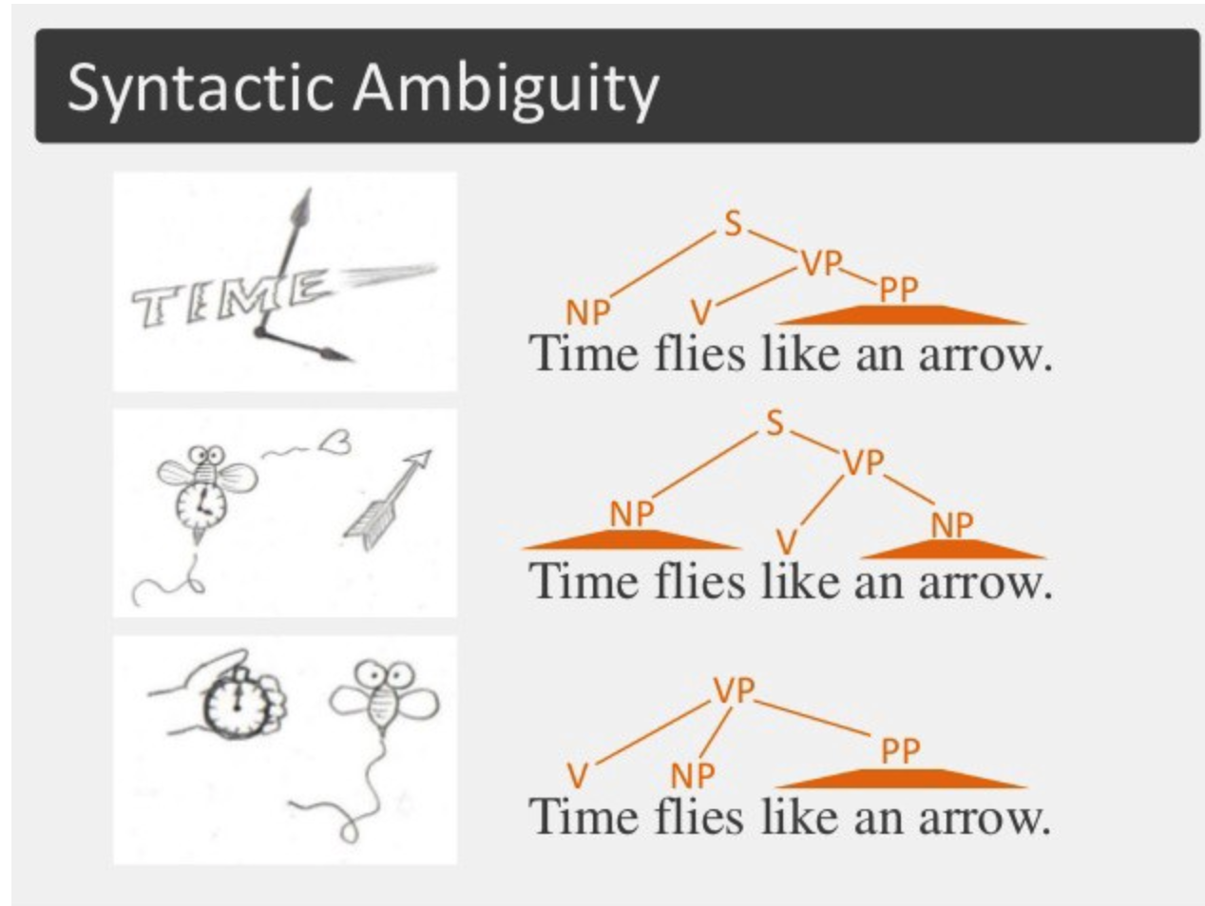
“Time flies like an arrow”
Notes:
Krovetz is a dictionary based stemmer

Slide 10
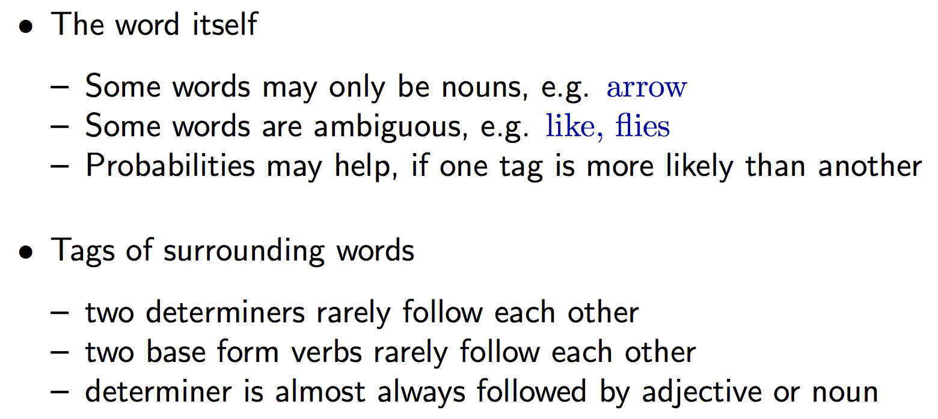
Relevant knowledge for POS tagging models
Notes:
Krovetz is a dictionary based stemmer

Slide 11
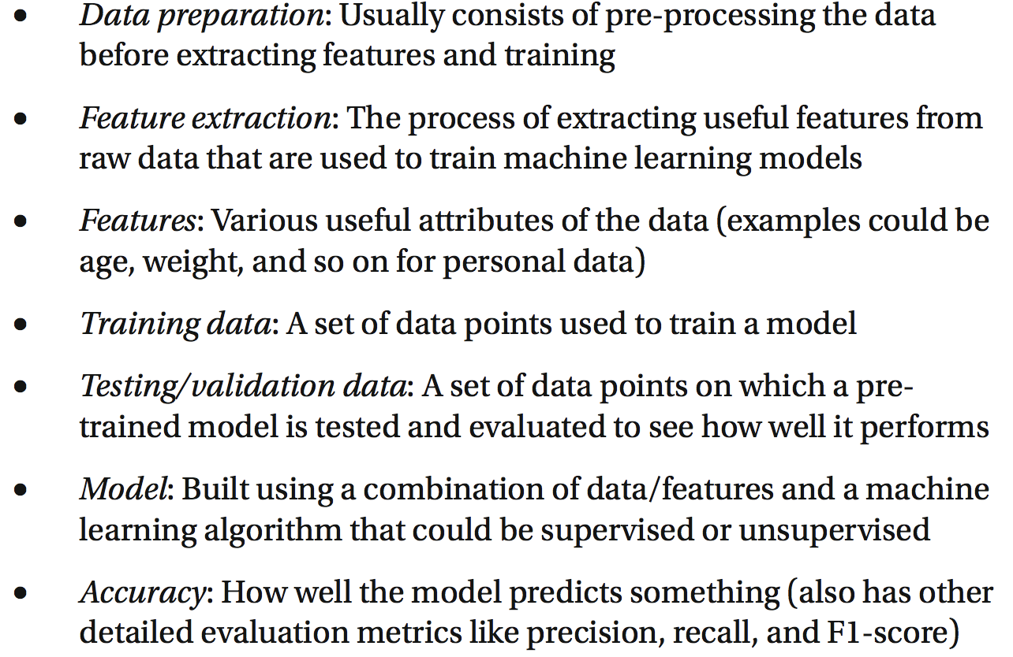
Machine Learning refresher

Slide 12
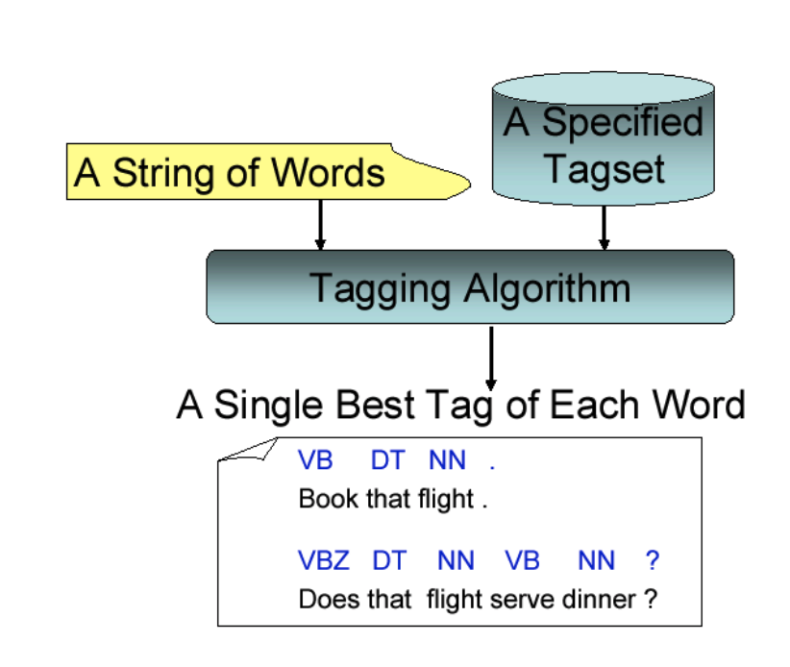
POS Tagging

Slide 13
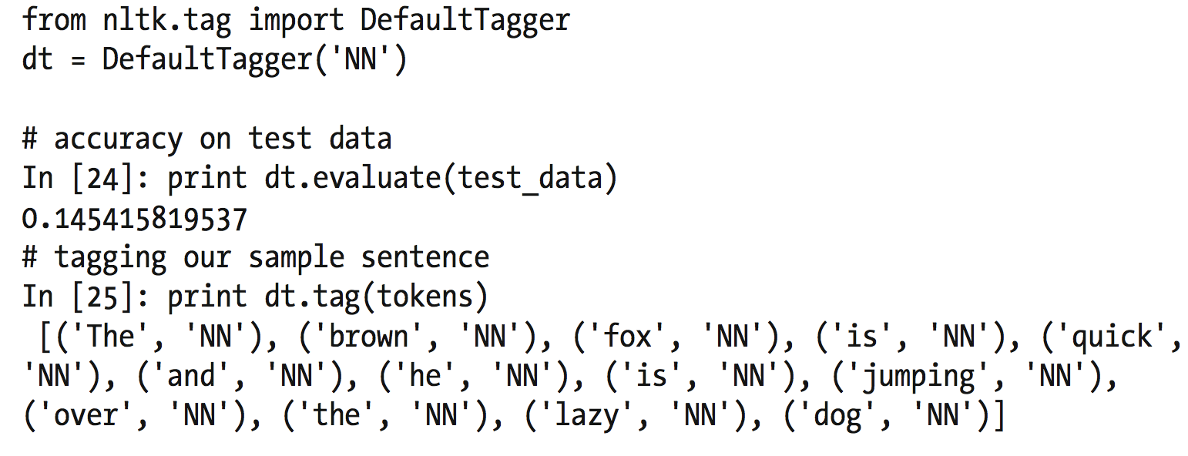
Automatic Tagging: Default Tagger
The Default Tagger: assigns the same tag to each token; good for establishing a baseline
On test set, obtains 14% accuracy

Slide 14
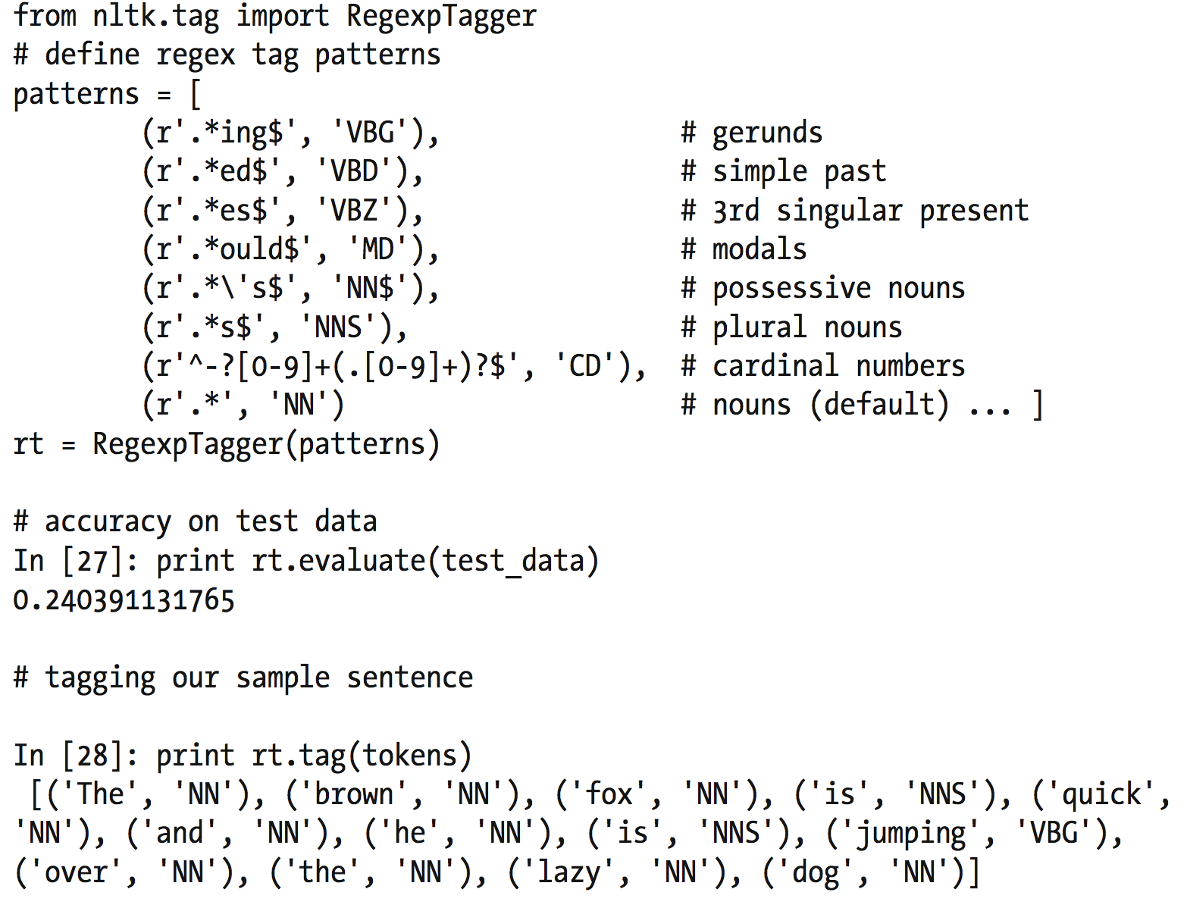
Automatic Tagging: RegExp Tagger
The RegExp Tagger: assigns tokens based on matching patterns
E.g., any word ending in ed
is the past principle of a verb,
and any word ending with
‘s is a possessive noun
Accuracy increased to 24%

Slide 15
Automatic Tagging : N-Gram tagging
Unigram tagging: uses a statistical algorithm (using training data) to assign
the most likely tag for a token
Uses only one item of context. E.g., would tag the word wind with the same
tag for both the wind or to wind.
N-gram tagger: generalization of the tagger whose context is the current word
together with the POS tags of the n-1 preceding tokens. E.g., n= 3

Slide 16
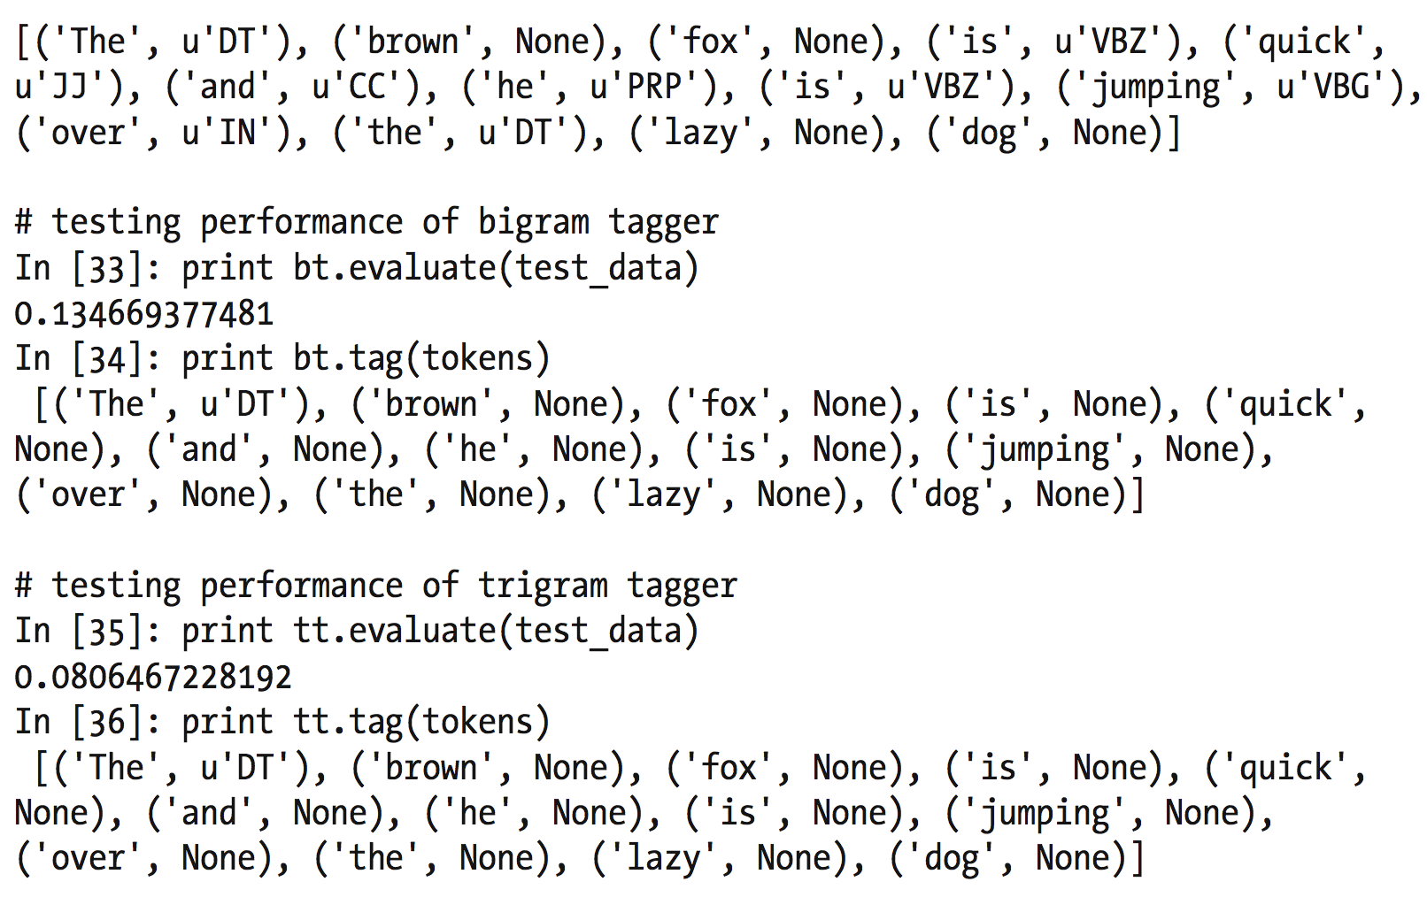
Automatic Tagging : N-Gram tagging
Unigram: 86%, Bigram: 13.4%, Trigram: 8%
Why is bigram and trigram accuracy lower?

Slide 17
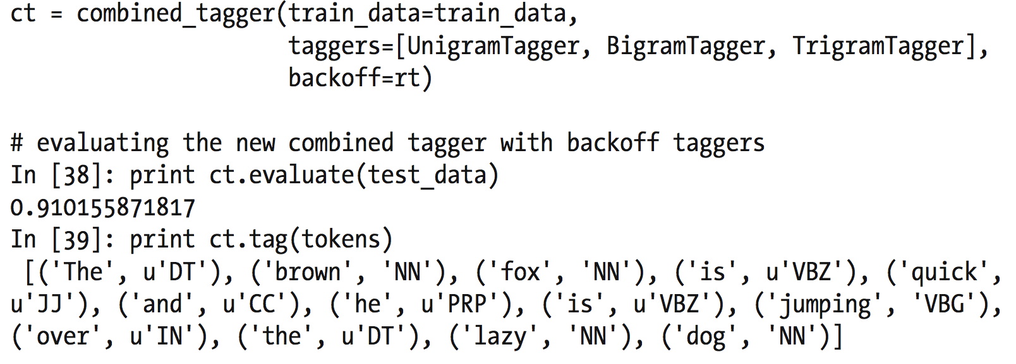
Automatic Tagging : Combined Tagger
Combined Tagger: create a chain of taggers, and each tagger would fall back on a backoff tagger
if it cannot tag the input tokens
Accuracy: 91%

Slide 18
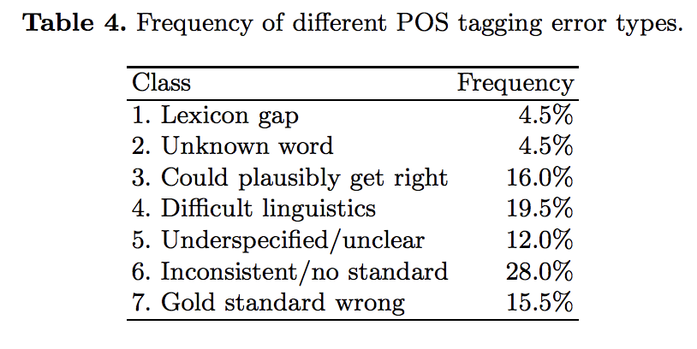
Part of Speech (POS) Tagging – “from 97% to 100%” C Manning https://nlp.stanford.edu/pubs/CICLing2011-manning-tagging.pdf
Despite POS tagging being viewed as a “solved” problem, there is still opportunity for improvement.
Biggest opportunity is not from machine learning or feature engineering but in improving training data.
There has been resistance to improving training/corpus data – “real world is noisy”, ”overfitting”, etc.
Notes:
https://nlp.stanford.edu/pubs/CICLing2011-manning-tagging.pdf

Slide 19
Types of POS taggers – Rule-based taggers
Composed of large number of handcrafted rules
Use contextual information to assign tags to ambiguous/unknown words
E.g., If word W is preceded by a determiner and followed by a noun, tag it as an adjective
Words ending with “ed” or “ing” must be tagged as a verb
Process is not scalable, very manual and cumbersome.
Brill Tagger (supervised learning) analyzes corpus/training data to find the set of tagging rules that minimize tagging errors and best define the corpus.

Slide 20
Types of POS taggers – Stochastic taggers
Stochastic: models that incorporate frequency and/or probability (Bayesian learning, maximum likelihood, naïve bayes,
Frequency-based: assign tag that occurs most frequently with the word in the training data.
Probability-based: calculate the probability of occurrences of a given sequence of tags; best tag for a word is determined by the probability that it occurs with the n previous tags (context, n-gram)
Hidden Markov Models: combines frequency and probability based approaches

Slide 21
Markov Chain Models
Markov Chain Model example:
Sunny, Rainy, Cloudy, Sunny, Sunny, Sunny, Rainy

Slide 22
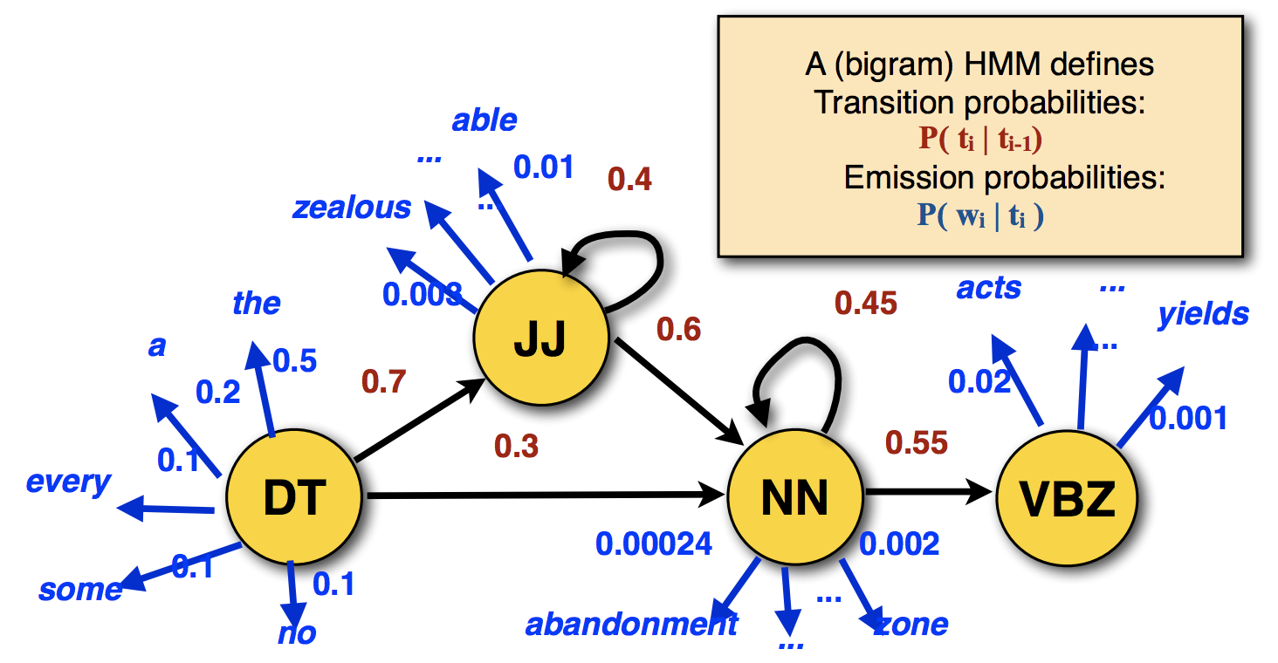
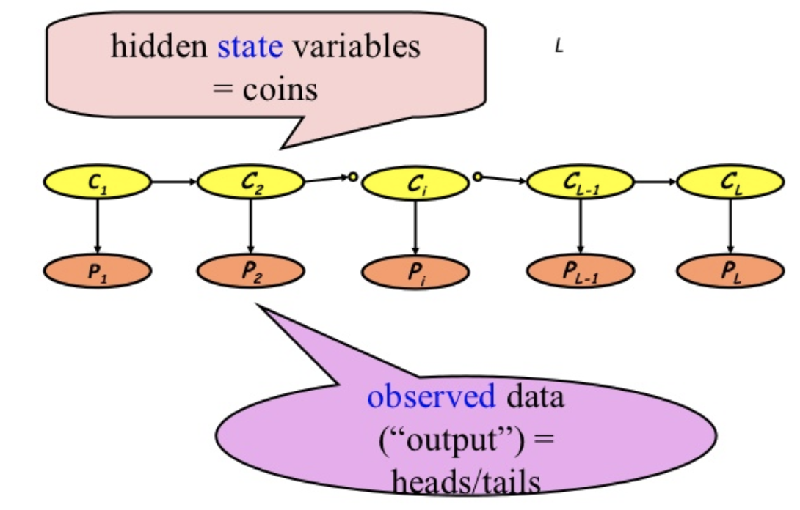
Hidden Markov Models (HMMs)
States (hidden): Rainy, Sunny
Observations: Walk, Shop, Clean
Emission probabilities: probabilities of making certain
observations given a particular state
Transition probabilities: probability of transitioning to
another state given a particular state

Slide 23
Viterbi algorithm
Find the most likely sequence of tags given a set of observations x1 … xn
E.g., observations (N) = the dog barks , possible tags (T)= {D, N, V}
Set of possible sequences: 3^3 (T^N)
Instead of a brute force algorithm, use Dynamic Programming
Dynamic programming is a general technique to solve certain complex search problems by memorization
1.) Recursively decompose the large search problem into smaller subproblems that can be solved efficiently –There is only a polynomial number of subproblems.
2.) Store (memoize) the solution of each subproblem in a common data structure –Processing this data structure takes polynomial time

Slide 24
Dynamic Programming – Fibonacci Series
Recursive formula:
Fib(0) = 0, Fib(1) = 1
Fib(n) = Fib(n-1) + Fib(n-2) for all n >= 2
Example:
Fib (5) = Fib(4) + Fib(3)
......
Fib (5) = Fib(1) + Fib(0) + Fib(1) + Fib(1) + Fib(0) + Fib(1) + Fib(0) + Fib(1)

Slide 25
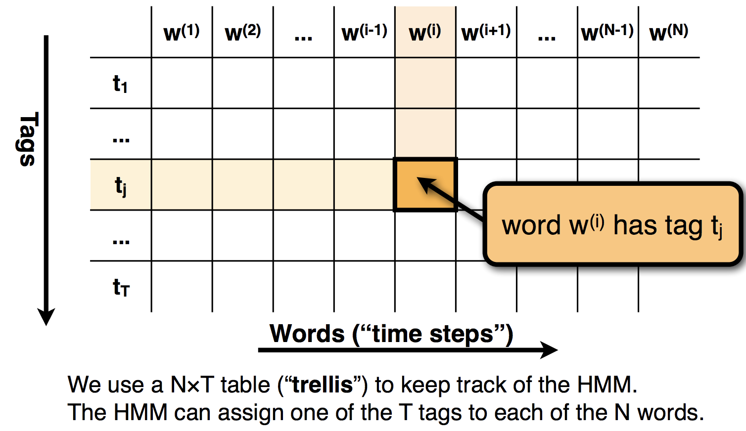
Viterbi algorithm

Slide 26
What did you learn today?
Questions?

